Slide 1
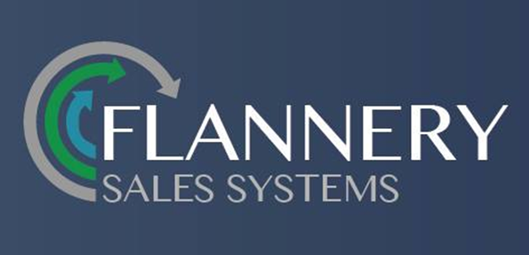
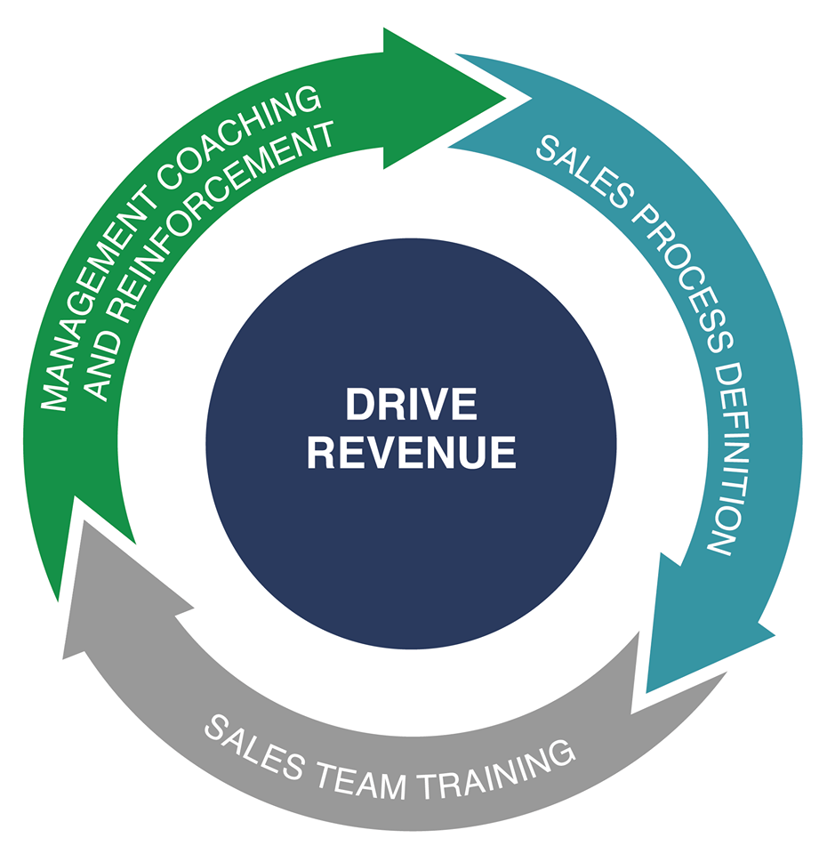
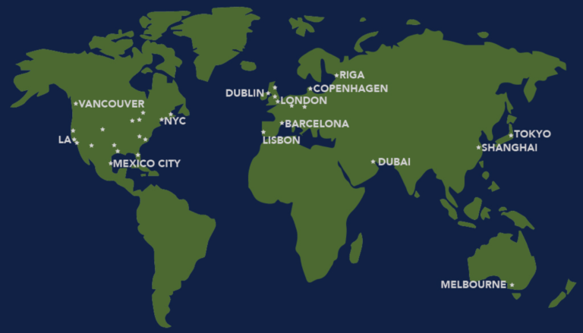
3 Ways to Drive Revenue:
Sales Process Definition is the tactical execution of Commercial Strategy
(refined for new products, markets or acquisitions)
Focus on skill development for all in Customer Facing Roles (Field & Inside Sales, Marketing, Customer Service, etc.)
Success lies in Management Coaching of sales skills for revenue generation
13 December

Slide 2
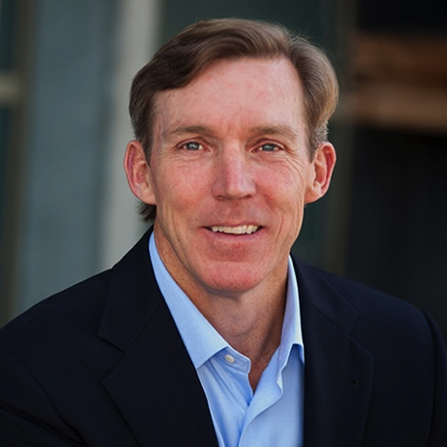
About Our Leadership
John E. Flannery –
John works with our customers to develop specific revenue generation programs based around sales process. He also provides them with the supporting implementation services to help companies maximize their investment and drive results.
With 33 years of sales, sales management, and business ownership experience, John has a comprehensive understanding of how sales organizations should run. After 10 years in two Fortune 500 companies, he founded, built, and sold his own business in the wireless industry. As the lead sales executive in a multinational organization , John drove the implementation of sales process into that company.
The Flannery Sales Systems team has worked with customers across 17 countries in North America, Europe, Asia, and the Middle East, and the attendees of these programs represent 21 different languages.
John is a graduate of San Diego State University, and he currently sits on the Marketing Advisory Board for the College of Business at SDSU.

Slide 3
Our Customers and Their Success Stories
Each of our customers works with us to define what a successful program looks like for their organization.
Some of the most common metrics include:
Increase top line revenue results
Improve margins
Increase the quality of opportunities in the pipeline
Increase the overall revenue in the pipeline
Decrease the ramp up time of new hires
Reduce SGA (Selling expense)
Specific results will be provided on request to maintain the confidential disclosures with customers

